Slide 1
Web Engineering
Lecture 4
N-Tier Architecture
Dr. Zulfiqar Ahmad
Department of CS & IT
Hazara University Mansehra
zulfiqarahmad@hu.edu.pk

Slide 2
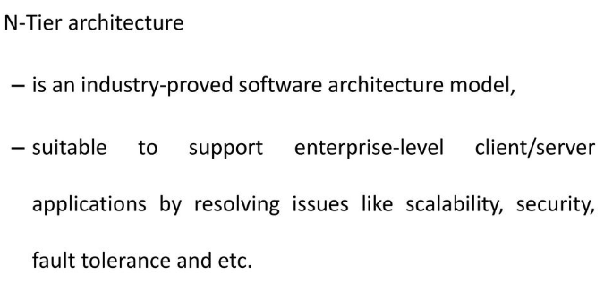
N-Tier Architecture

Slide 3
Significance of “Tiers”
N-tier architectures have three components
Presentation
Business/Logic
Data
N-tier architectures try to separate the components into different tiers/layers
Tier: physical separation
Layer: logical separation

Slide 4
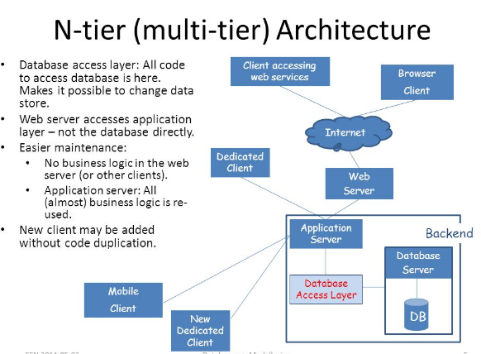


Slide 5
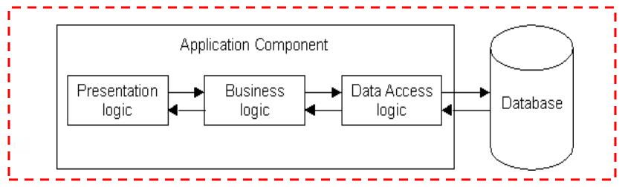
1-Tier Architecture
All 3 layers are on the same machine
All code and processing kept on a single machine
Presentation, Logic, Data layers are tightly connected
Scalability: Single processor means hard to increase volume of processing
Portability: Moving to a new machine may mean rewriting everything
Maintenance: Changing one layer requires changing other layers

Slide 6
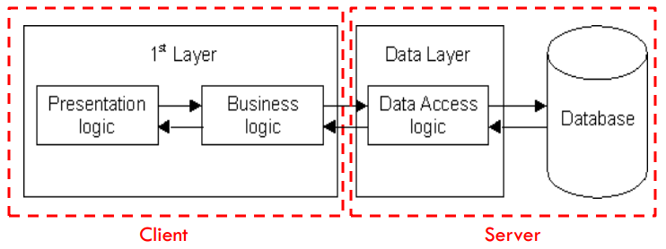
2-Tier Architecture
Database runs on Server
Separated from client
Easy to switch to a different database
Presentation and logic layers still tightly connected (coupled)
Heavy load on server
Potential congestion on network
Presentation still tied to business logic

Slide 7
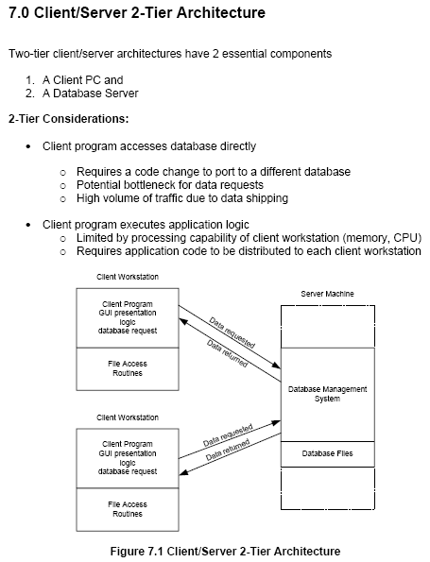

Slide 8
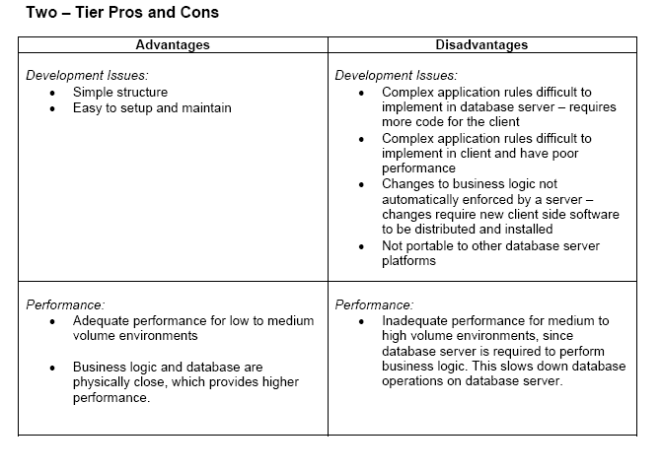

Slide 9
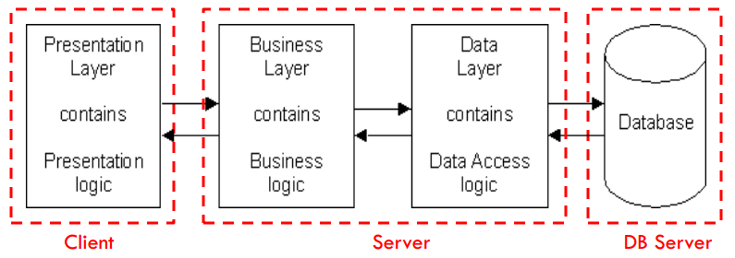
3-Tier Architecture
Each layer can potentially run on a different machine
Presentation, logic, data layers disconnected

Slide 10
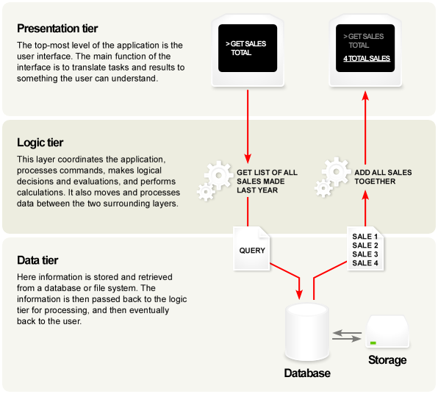
A Typical 3-tier Architecture
Architecture Principles
Client-server architecture
Each tier (Presentation, Logic, Data) should be independent and should not expose dependencies related to the implementation
Unconnected tiers should not communicate
Change in platform affects only the layer running on that particular platform
Notes:
Three tier functionalities architecture

Slide 11
A Typical 3-tier Architecture
Presentation Layer
Provides user interface
Handles the interaction with the user
Sometimes called the GUI or client view or front-end
Should not contain business logic or data access code

Slide 12
A Typical 3-tier Architecture
Logic Layer
The set of rules for processing information
Can accommodate many users
Sometimes called middleware/ back-end
Should not contain presentation or data access code

Slide 13
A Typical 3-tier Architecture
Data Layer
The physical storage layer for data persistence
Manages access to DB or file system
Sometimes called back-end
Should not contain presentation or business logic code

Slide 14
The 3-Tier Architecture for Web Apps
Presentation Layer
Static or dynamically generated content rendered by the
browser (front-end)
Logic Layer
A dynamic content processing and generation level
application server, e.g., Java EE, ASP.NET, PHP, ColdFusion
platform (middleware)
Data Layer
A database, comprising both data sets and the database
management system or RDBMS software that manages and provides access to the data (back-end)

Slide 15
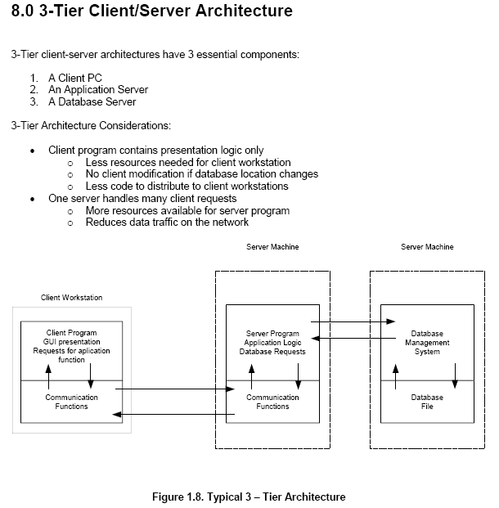
Notes:
General Architecture

Slide 16
Run as slide show to see animated display.
3-Tier Architecture
Browser
client
Web
server
Browser sends
URL to web server,
requesting a file or
program
Fetches file or runs
server side (php) script
Apache web server
SQL programming interface:
SQL commands sent
- results returned
PHP
script
1
Server returns results
file and/or program outputs
2
HTML5
CLI for PHP
and mysql
phpMyAdmin
provides separate
browser-based
GUI interface
CSS
HTML: Browser displays (renders)
resulting page
PHP
MySQL
Database
SQL
3
MySQL
JavaScript: executed by browser
jQuery AJAX: ‘direct’ asynchronous web server connection
Javascript
HTTP (developer tools)
AJAX, jQuery notation
JSON, web services
Full stack development
Integrated development
Command Line Interface (CLI)
(eg in MobaXterm) provides alternative DB interface
mysql commands → performance
php in CLI →error reporting
Also online meandeviation.com PHP syntax tool
Notes:
Real world implemented architecture

Slide 17
Web sites based on data
Web Client / user
Web Server
Database server
1. User requests a page
2. HTTP request sent
3. SQL query
4. Server executes query
Runs program or script
data returned
5. Server script copies data in HTML format
Response
Web page on screen
The “three tier architecture”
Notes:
Web sites based on data

Slide 18

Some technologies to use
Web Client / user
Web Server
Database server
Any Web browser
Client languages:
HTML, CSS, JavaScript
Apache (most popular)
Server language:
PHP
MySQL
Query language:
SQL
Bundled in the package

Slide 19
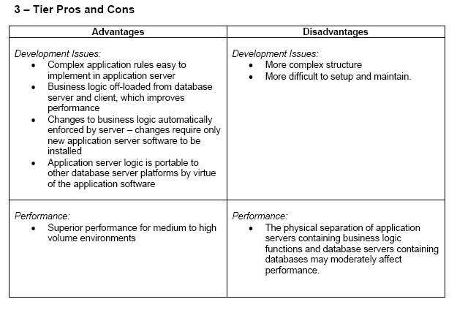

Slide 20
